Slide 1


Electric Vehicle Market and Performance Analysis

Slide 2

Introduction:
Focuses on Electric Vehicle (EV) Market Analysis using real-world automotive data.
Aims to identify the key factors influencing EV pricing, performance, and efficiency.
Employs Exploratory Data Analysis (EDA) to reveal trends, correlations, and insights.
Data collected through web scraping from trusted EV industry sources.
Analyzes relationships among battery capacity, range, acceleration, and charging speed.
Provides actionable insights for manufacturers, policymakers, and EV consumers.

Slide 3

Business Problem:
The rapid expansion of the EV market has led to vast differences in pricing, range, and performance among brands.
Consumers struggle to identify which specifications provide the best value for money.
Manufacturers lack clear insights into which factors most influence EV market pricing and demand.
A structured data-driven analysis is needed to uncover patterns linking price, performance, and efficiency across EV models.

Slide 4
Objectives
To analyze relationships between EV price, performance, efficiency, and brand characteristics.
To identify key factors that most influence the market value of electric vehicles.
To visualize trends and correlations using Exploratory Data Analysis (EDA) techniques.
To generate actionable insights that support data-driven decisions for manufacturers and consumers.

Slide 5
The Dataset & Target Variable
Source: https://ev-database.org/
Scope: 973 EV models, 15 features.
Key Features:
Performance: Battery Capacity, Real-World Range, Energy Efficiency, Acceleration, Fast Charging.
Design: Vehicle Weight, Towing Capacity, Cargo Volume.
Brand & Market: Brand, Vehicle Status (Available/Discontinued), Availability Years.
🎯 Target Variable: Price (€) - The market price in Euros, serving as the primary indicator of value.

Slide 6

Web Scraping
Extracted Electric Vehicle (EV) data from a reliable automotive database using Python.
Utilized BeautifulSoup and Requests libraries to parse and collect data efficiently.
Captured essential attributes like Brand, Model, Price, Range, Battery Capacity, and Efficiency.
Stored extracted data in a structured CSV format for further cleaning and EDA.
Ensured data accuracy by validating entries and handling missing or inconsistent values.

Slide 7






Tools Used

Slide 8
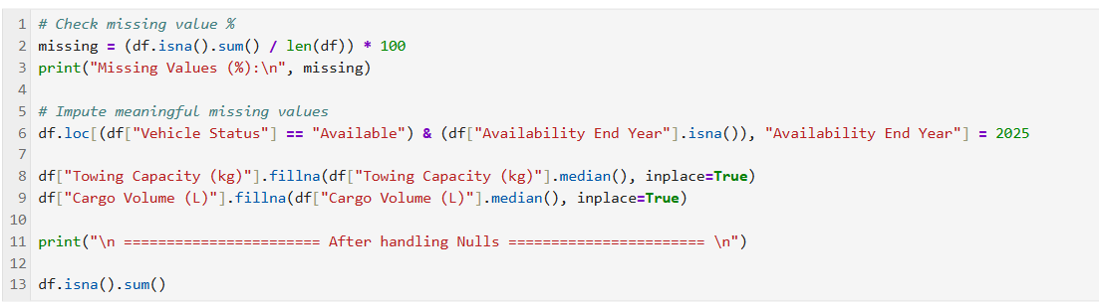
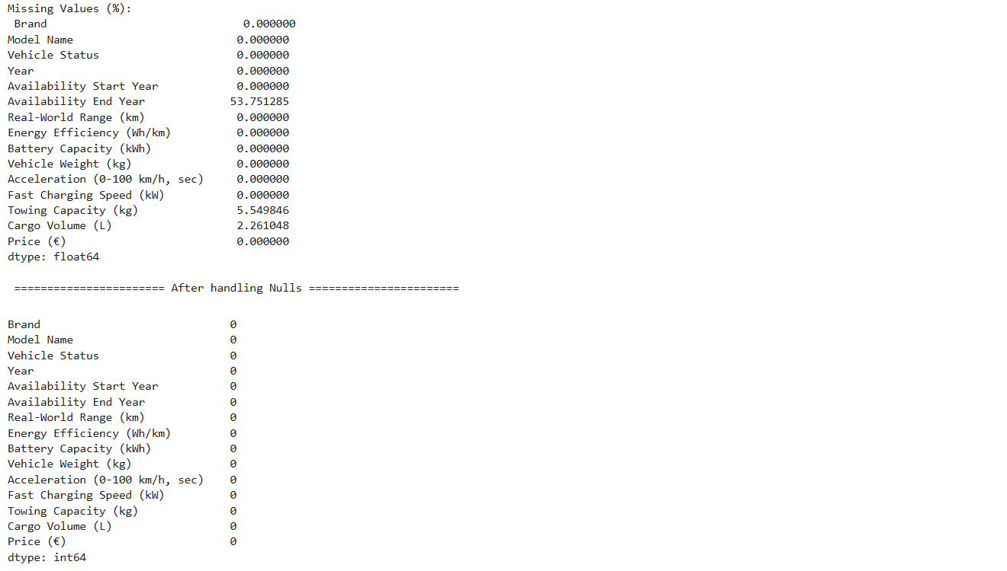
Data Cleaning Steps
Initial State: Dataset had some missing values that required attention.
Handled Missing Values Intelligently:
Availability End Year: For "Available" vehicles, missing values were set to 2025 (current/future year), which is logical.
Towing Capacity (kg) & Cargo Volume (L): Missing values were filled with the median value of their respective columns, a robust statistical method.
Result: A clean, complete dataset with 973 rows and 15 columns, ready for robust analysis.

Slide 9
PART 1: UNIVARIATE ANALYSIS

Slide 10
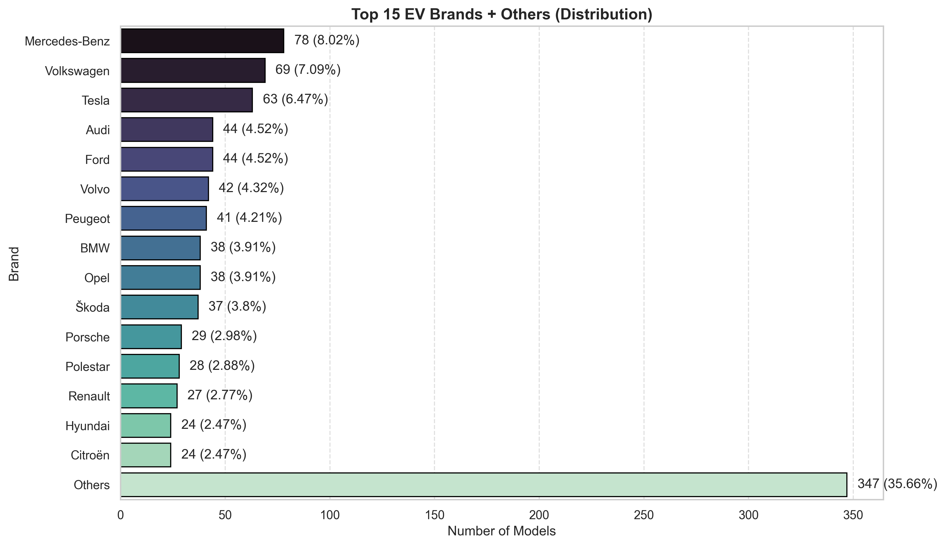
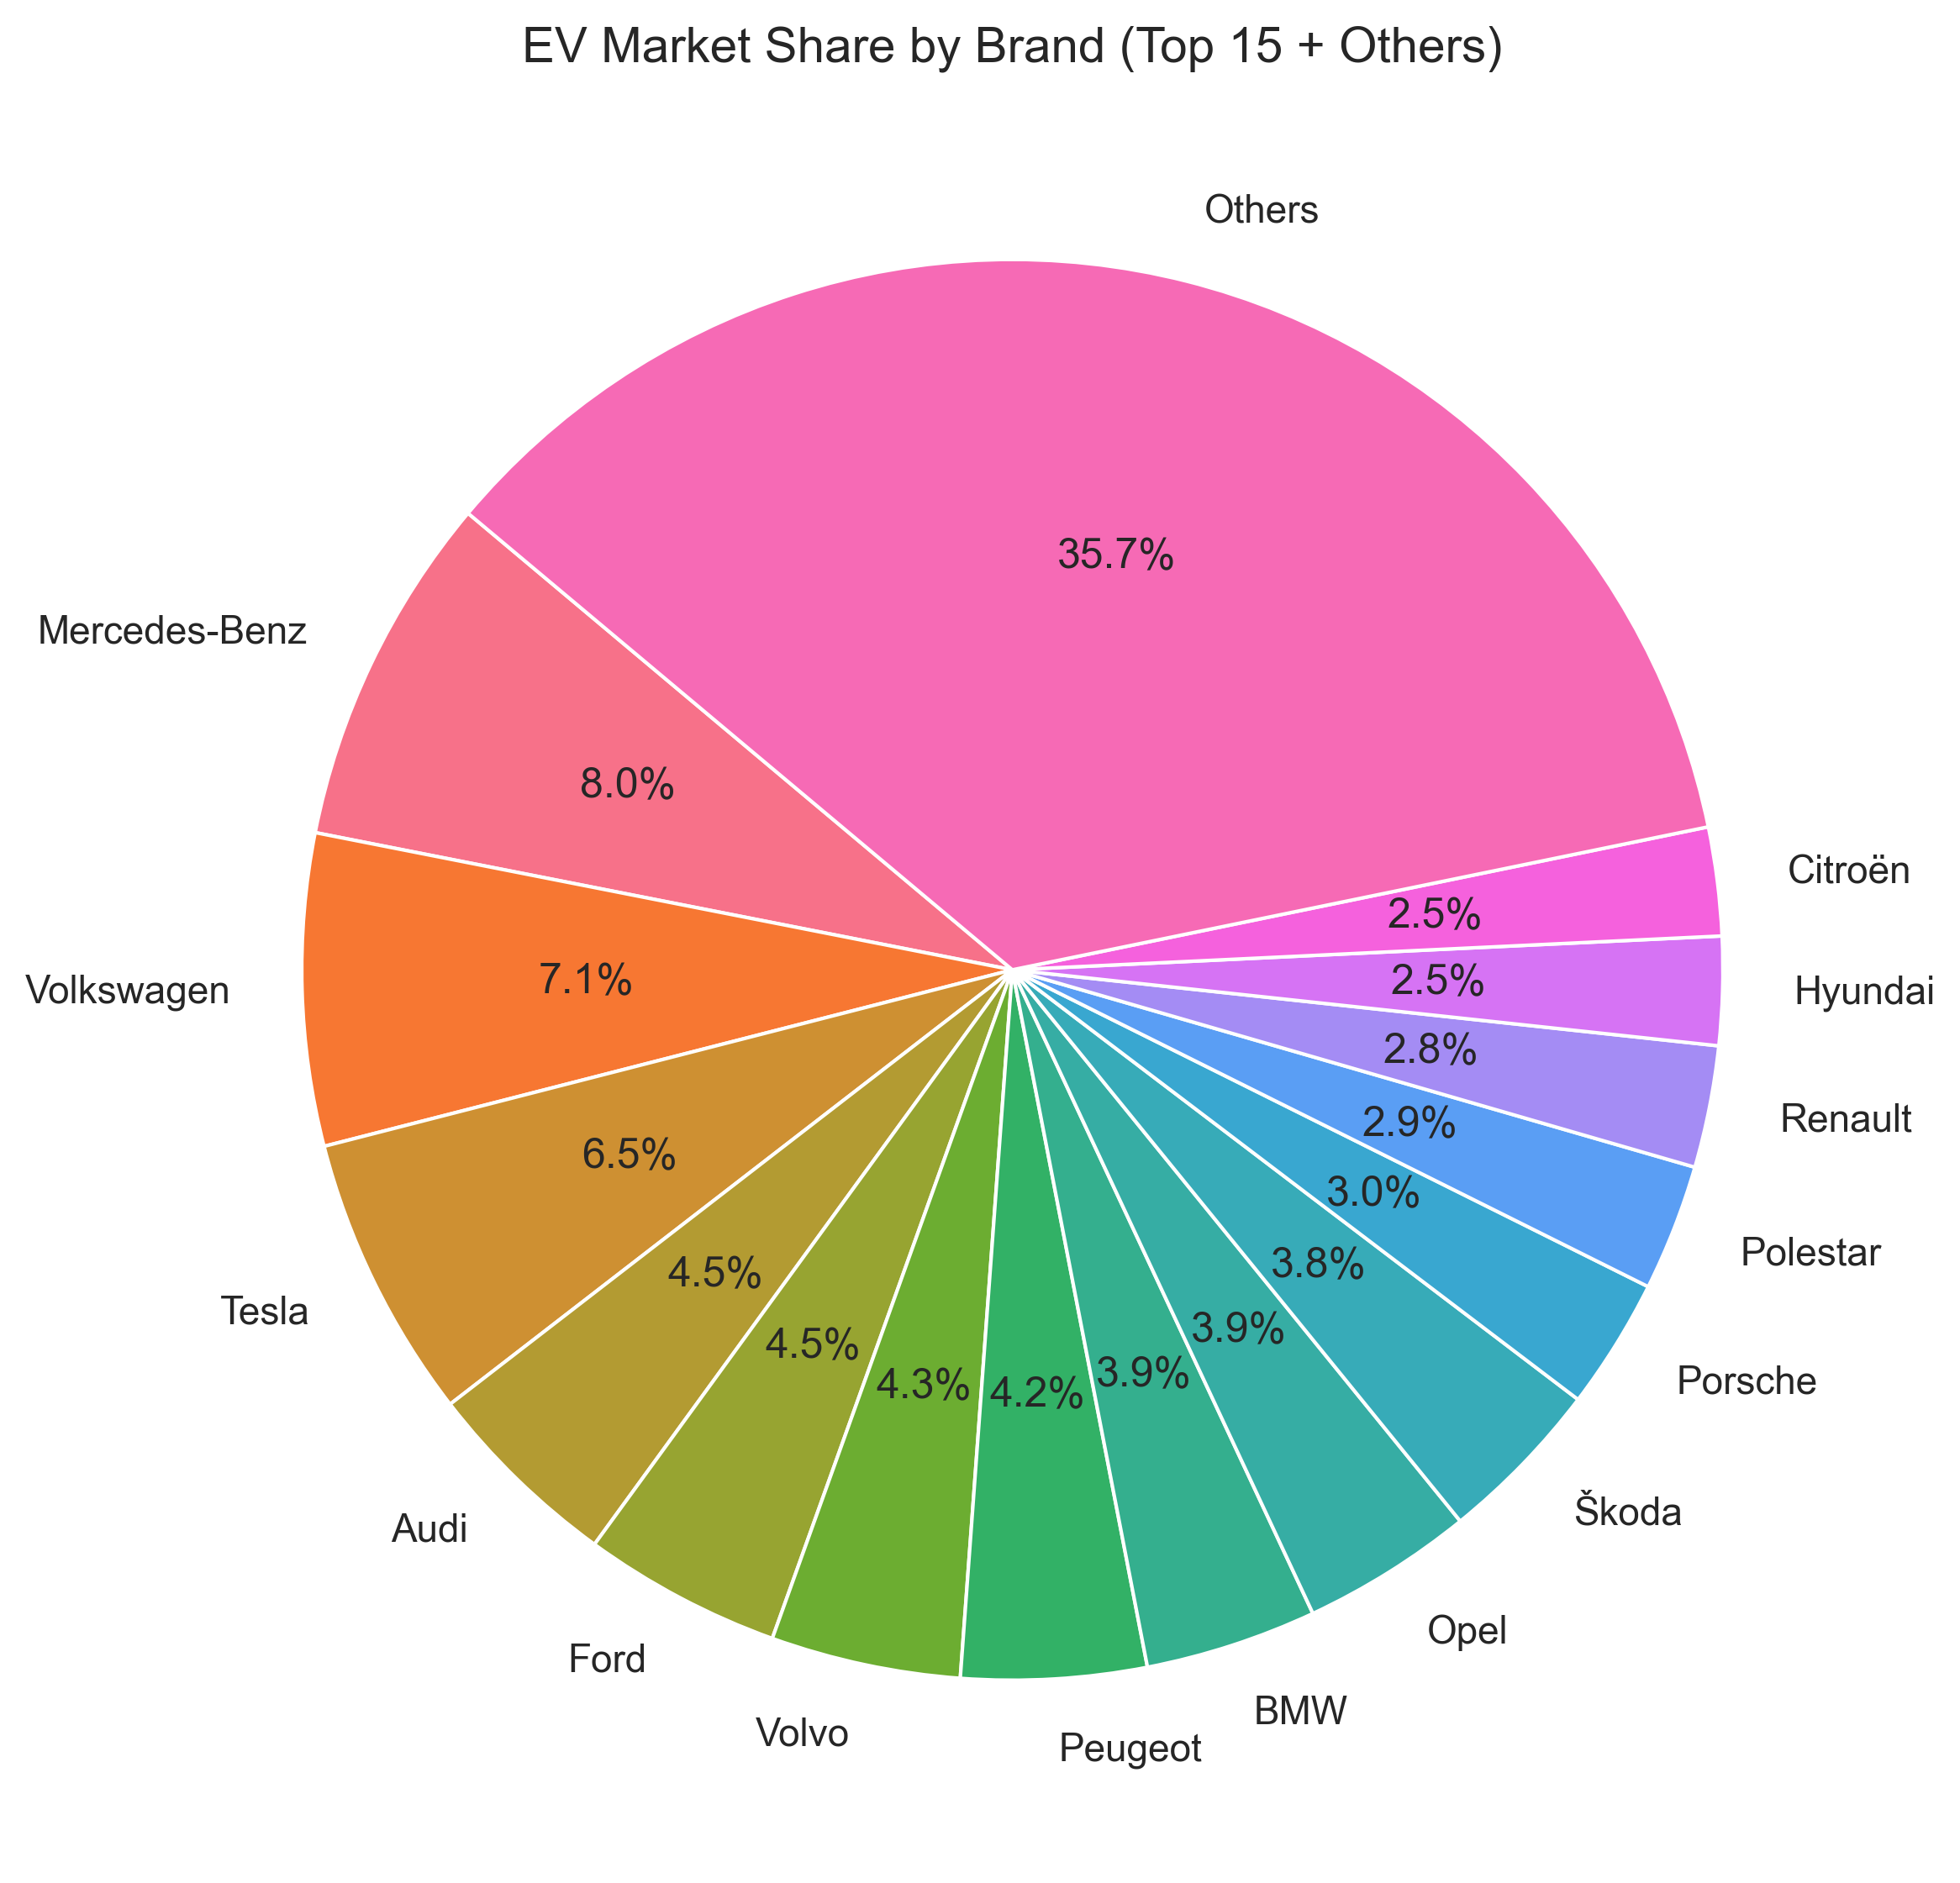
Brand Market Share Analysis
Market Leadership: Mercedes-Benz, Volkswagen, and Tesla collectively dominate the EV space, holding over 21% of the total market share.
Brand Concentration: The top 15 brands account for 64.3% of EV models, showing moderate concentration among key players.
Long Tail Effect: A significant 35.7% of models belong to 59 smaller brands, indicating a wide but fragmented competitive field.
Regional Dominance: European automakers, especially German brands, play a central role in shaping the global EV landscape.

Slide 11
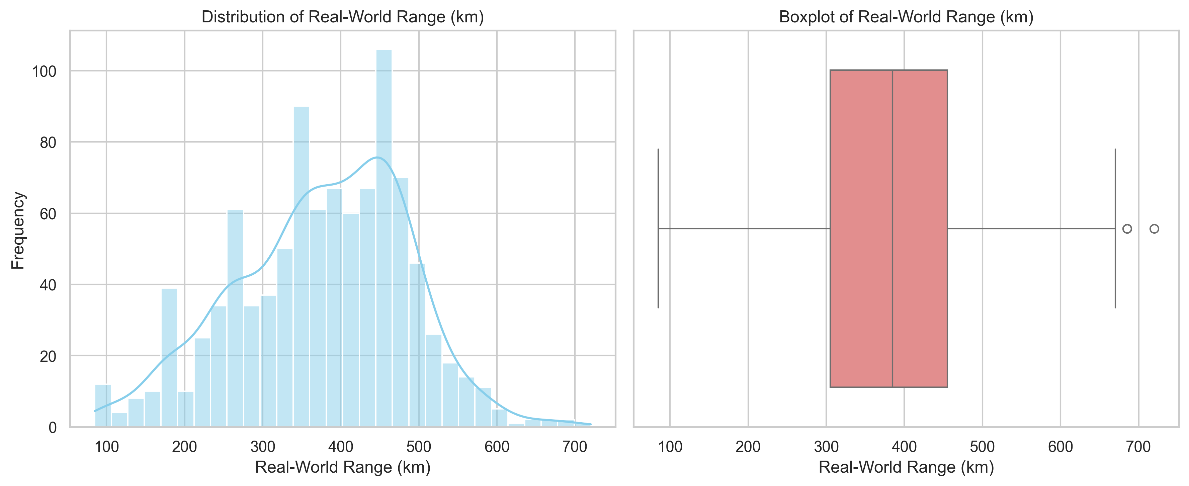
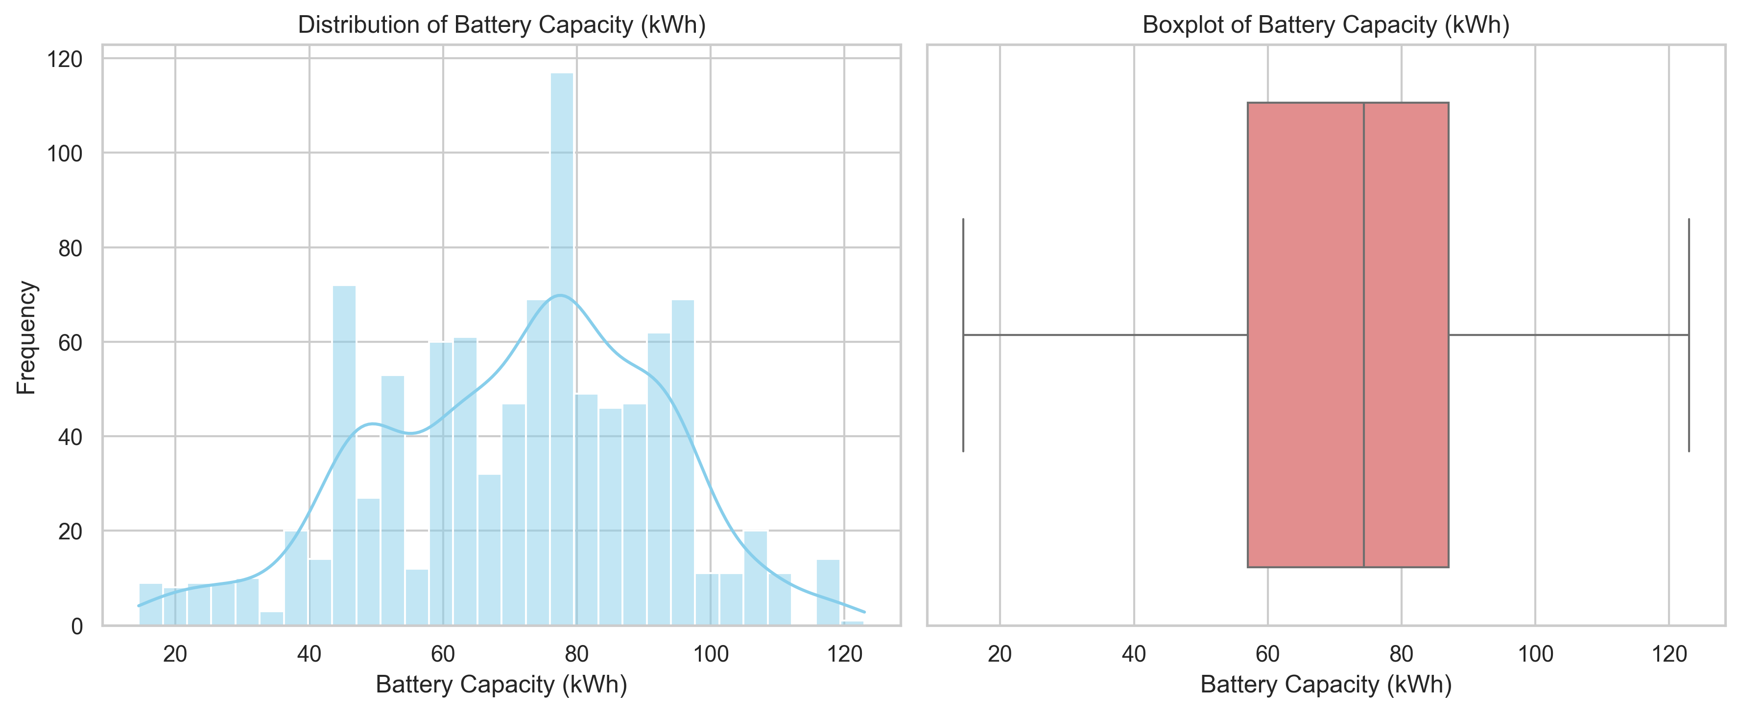
Key Performance Metrics Distribution
Typical Range: Most EVs offer a real-world range between 300–450 km, aligning with mainstream consumer expectations.
Battery Benchmark: The average battery capacity is 70–80 kWh, representing the core segment of the market.
Performance Balance: The market shows standardization around practical efficiency, balancing range and cost.
Premium Differentiation: High-end models exceed 100 kWh and 600 km, showcasing innovation and pushing performance limits.

Slide 12
PART 2: BIVARIATE ANALYSIS

Slide 13
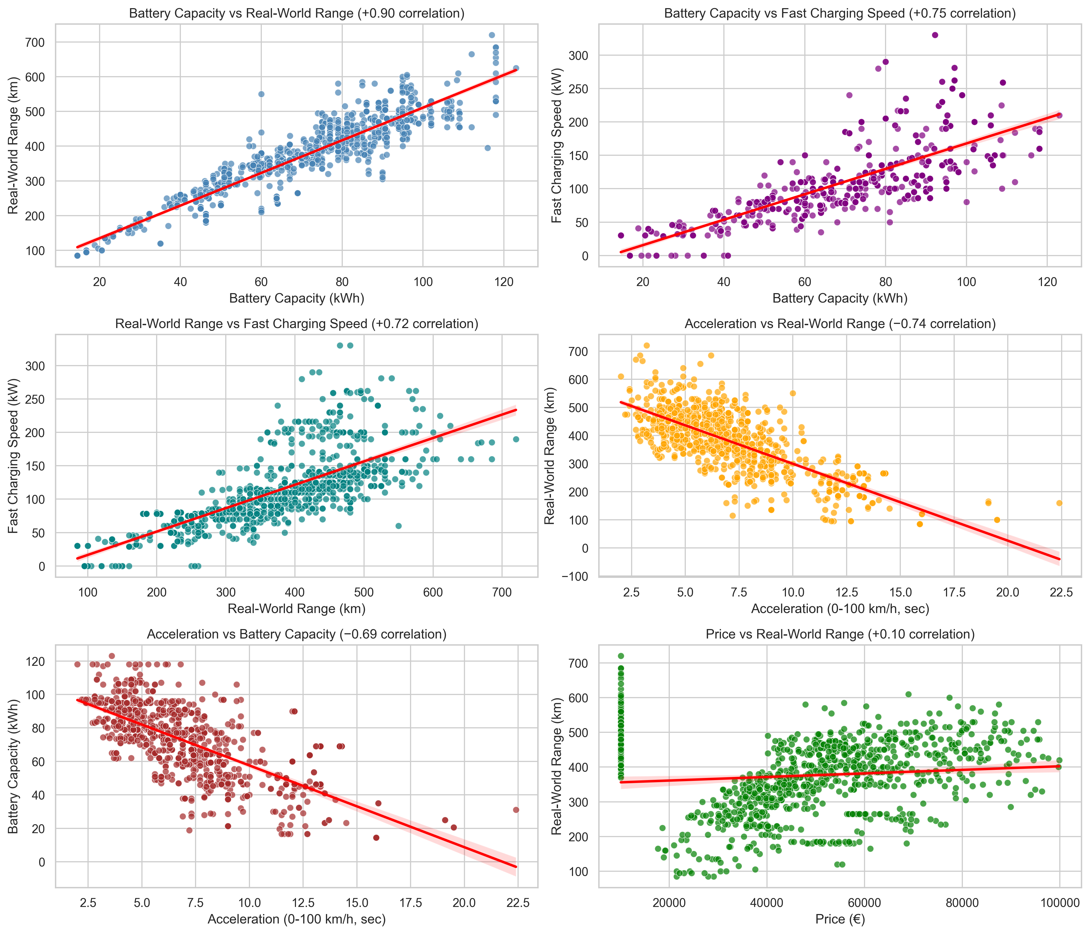
Critical Performance Relationships
Strong Efficiency Link: A high correlation (+0.90) between battery capacity and range shows that larger batteries directly enhance driving distance.
Charging Advantage: Bigger batteries support higher fast-charging speeds (+0.75), improving long-distance usability.
Performance Trade-off: Acceleration negatively correlates with range (-0.74), indicating that performance-focused EVs sacrifice efficiency.
Value Dynamics: The weak price-range correlation (+0.10) suggests that brand value and features influence pricing more than raw specifications.

Slide 14
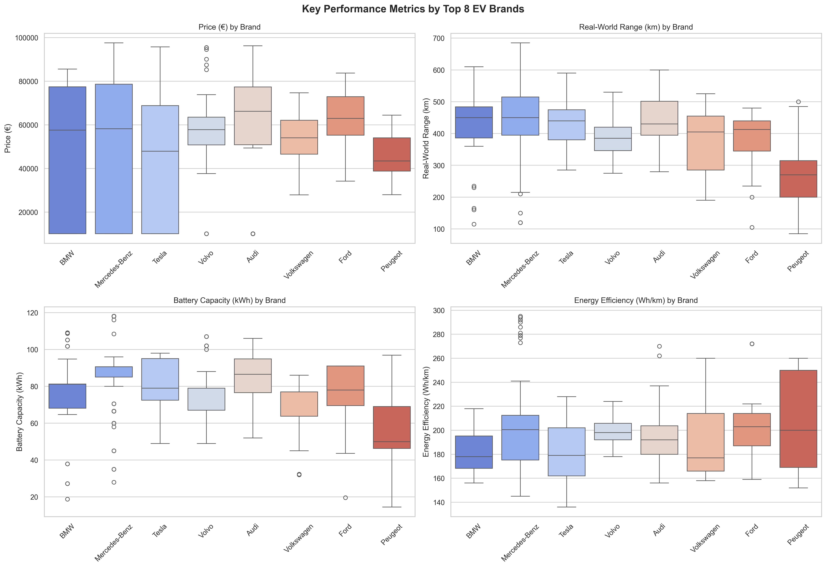
Brand Performance Positioning
Performance Excellence: Tesla and BMW lead in acceleration, highlighting their engineering focus on high performance.
Range Dominance: Audi and Mercedes-Benz achieve the longest real-world ranges, reflecting superior battery optimization.
Efficiency Benchmark: Tesla and BMW demonstrate best-in-class energy efficiency, optimizing power use per kilometer.
Strategic Positioning: Tesla combines strong range, top acceleration, and moderate pricing — creating a balanced, high-value EV proposition.

Slide 15
PART 3: MULTIVARIATE ANALYSIS

Slide 16
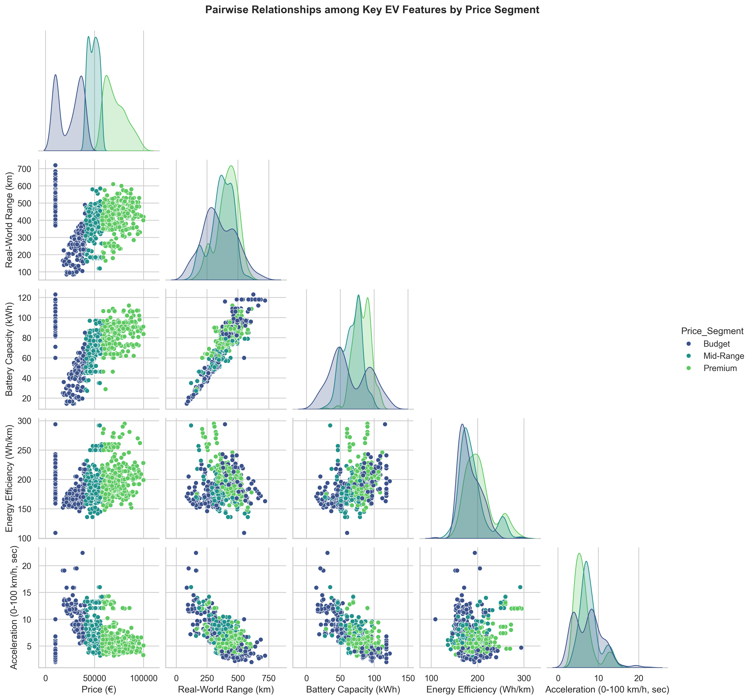
Market Segmentation Analysis
Budget EVs: Designed for urban use, featuring smaller batteries and shorter ranges for affordability and practicality.
Mid-Range Models: Offer a balance between range, performance, and price, ideal for family and all-purpose driving.
Premium Segment: Characterized by large batteries, long ranges, and advanced features, targeting performance and luxury buyers.
Market Segmentation: The data shows clear clustering by price and performance, confirming three well-defined EV market tiers.

Slide 17
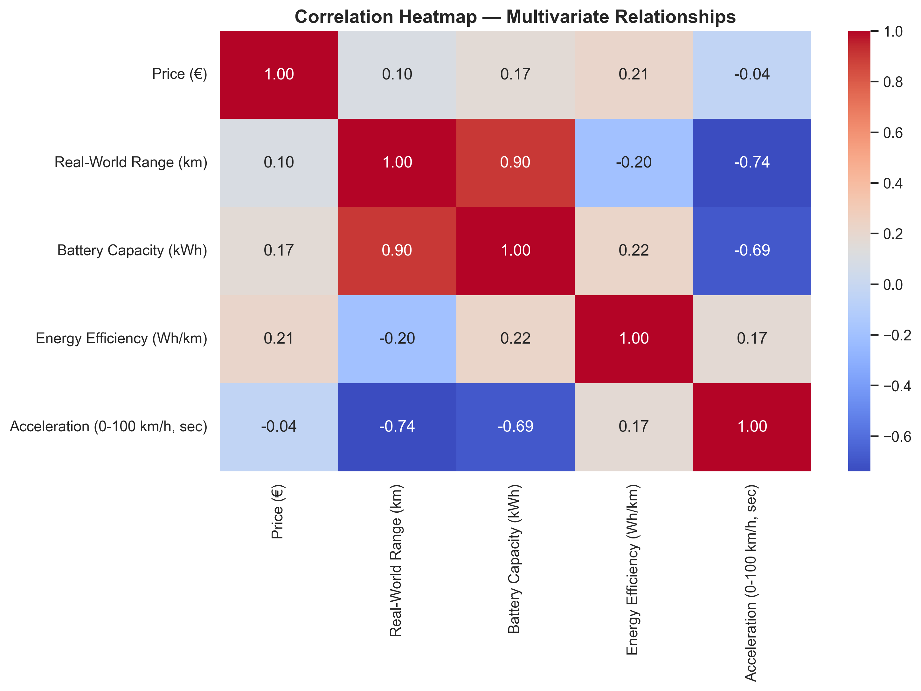
Multivariate Correlation Patterns
Strong Dependency: A high correlation (0.90) between battery capacity and range confirms that range primarily depends on battery size.
Performance Trade-off: A strong negative correlation (-0.74) between range and acceleration highlights efficiency versus power balance.
Weak Price Links: Price shows low correlation with technical specs, meaning features, design, and brand drive pricing more than performance.
Market Insight: EV pricing strategies are multi-factorial, blending engineering value with brand perception and technology positioning.

Slide 18
Key Business Insights & Recommendations
Battery capacity drives 90% of range - making it the most critical R&D focus area for competitive advantage.
Performance requires strategic trade-offs - faster acceleration (under 5s) reduces range by 25-30%, forcing clear market
Tesla sets innovation pace - 79% model discontinuation rate demonstrates aggressive product evolution cycles.
European dominance with clear segmentation - German brands lead across Budget (under €36K), Mid-Range (€36-62K), and Premium (over €62K) segments.
Charging & efficiency standards converging - 75% battery-charging correlation and 170-210 efficiency band show market maturation.

Slide 19
Conclusion
The EV market is steadily expanding, showing balanced competition among established automakers and emerging brands.
Rapid advancements in battery capacity, charging speed, and efficiency drive continuous model evolution.
Brands adopt varied strategies — from performance-oriented (Tesla, BMW) to efficiency-focused (Peugeot, VW) models — targeting different customer segments.
Growing focus on affordability, sustainability, and charging infrastructure will define the next phase of EV adoption worldwide.

Slide 20
Experience – Web Scraping & Data Analysis
Web Scraping: Extracted real-world EV data from online automotive sources using Python (BeautifulSoup & Requests).
Data Cleaning: Processed and standardized messy raw data — handled missing values, duplicates, and formatting issues.
Exploratory Data Analysis (EDA): Visualized trends in price, range, battery capacity, and efficiency using Pandas, Matplotlib, and Seaborn.
Insights Generation: Identified brand performance trends, price vs range correlations, and market segmentation patterns.
Practical Outcome: Built a structured, insight-rich dataset for understanding factors influencing EV market value.

Slide 21
Challenges – Web Scraping & Data Analysis
Data Inconsistency: Variations in website structures made data extraction and formatting difficult.
Missing & Noisy Data: Some EV specs were incomplete or contained non-standard units.
Data Cleaning Complexity: Handling mixed data types (numbers, text, symbols) during preprocessing.
Visualization Balance: Choosing clear visuals to summarize multi-dimensional relationships effectively.

Slide 22


